Slide 1
2D Singly Scattered MC Simulation
Under the guidance of Prof Pawel Moskal

Slide 2
Detector Geometry
Attenuation Coefficient (Lambda) = 0.5 cm-1
Thickness (d) = 2.0 cm
Width (w) = 10.0 cm
Radius (r) = 10.0 cm

Slide 3
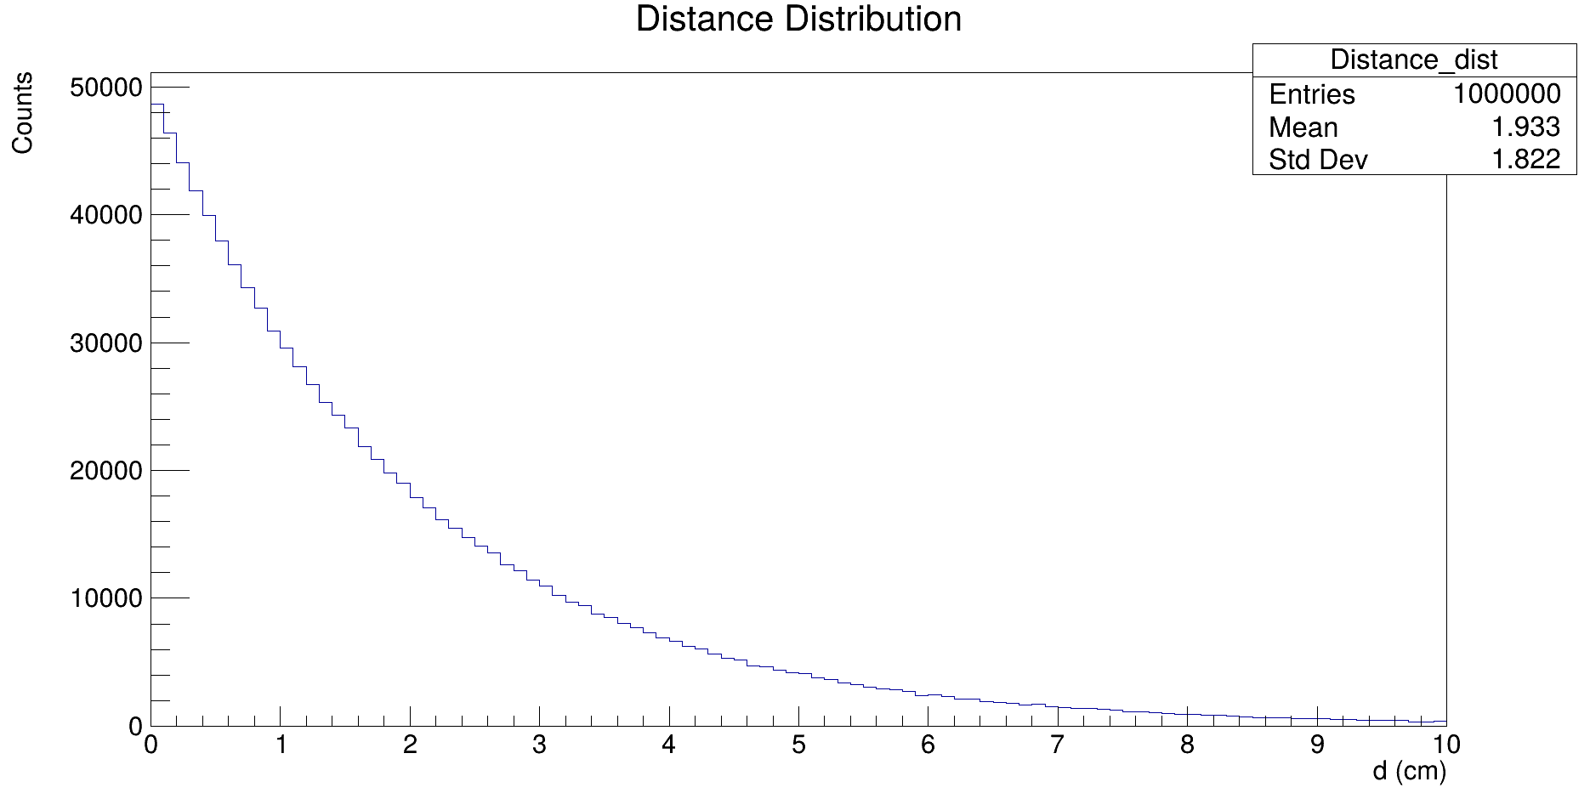
Simulate Distance (Inverse Transform Sampling)
Aim: Sampling distance from the Exponential Distribution.
Find the CDF of exponential distribution F(x).
Generate pseudorandom number u ~ random(0,1).
Calculate x = F⁻¹(u).

Slide 4
Angle Check (4 Sides)

Slide 5
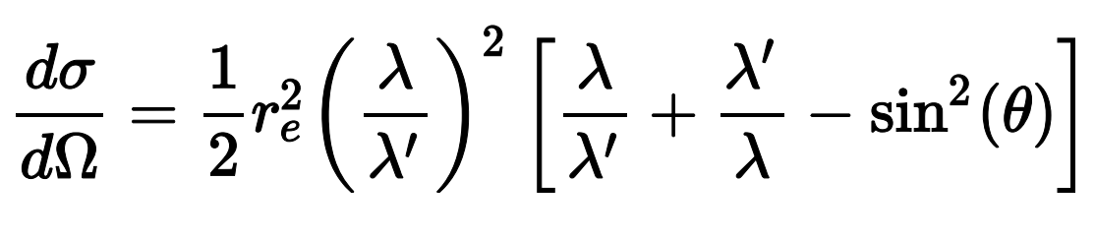
Simulate Theta (Rejection Sampling Method)
f(theta) = Klein-Nishina Formula as a function of theta;
f_max = f(0);
f = random(0,f_max);
theta ~ random(0,pi);
if (f<f_max)
return theta;

Slide 6
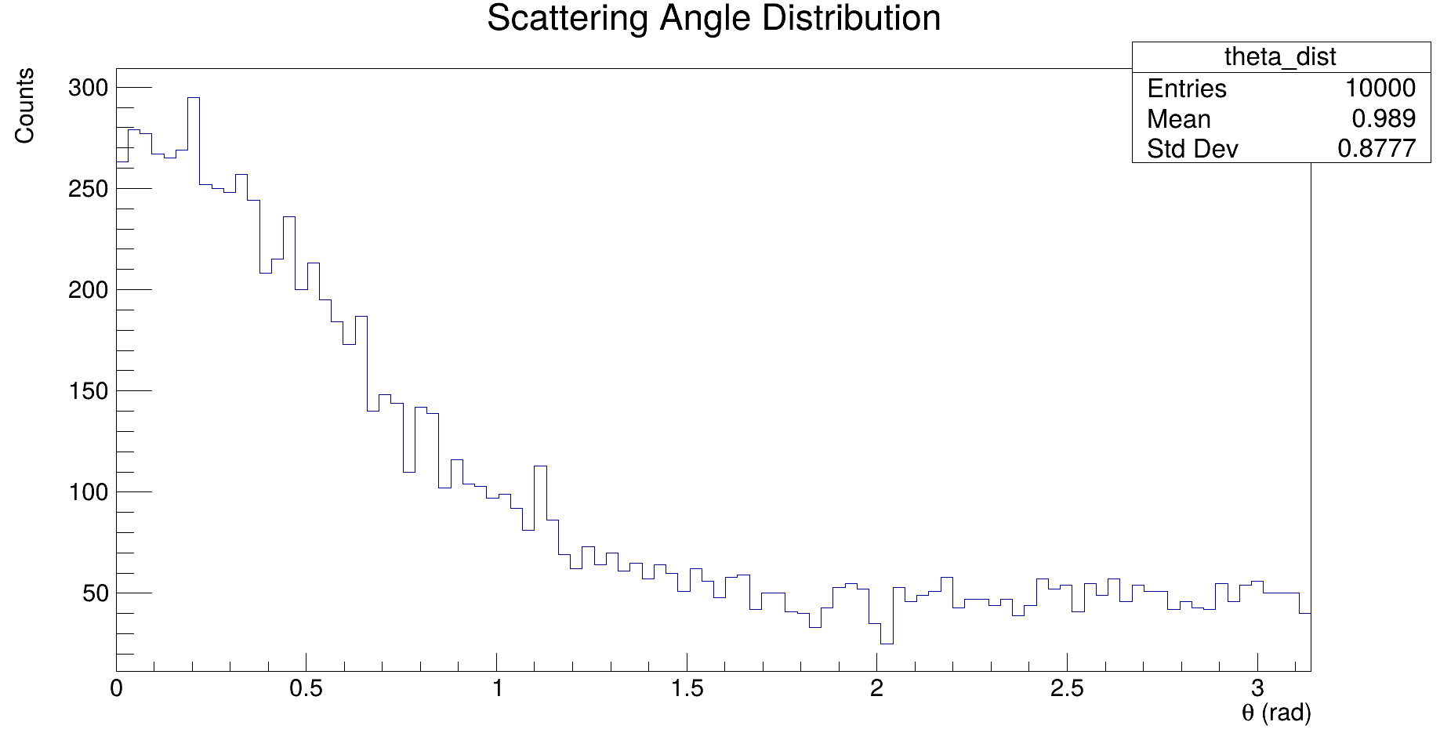

Slide 7
Photons
Go Inside detector
Doesn’t go inside detector
Detected
Undetected
Scattered
Unscattered (Complete Absorption)
Detected
Undetected
Within same detector
In different Detector
Scattering Inside the phantom
Detected
Undetected
Scattered
Unscattered
Detected
Undetected
Within same detector
In different detector
Note: Detection requires Energy Deposition and Scattering is mere interaction. Thus, undetected photons can scatter inside Detector.
Simplification: Photons that are scattered from the phantom aren’t detected.
Assumption: Energy Deposition & Scattering without deposition both follows exponential distribution.

Slide 8
Detected

Slide 9
Simulation Results (Efficiencies/Fractions)

Slide 10
Theoretical Results (& Comparison)
Simulation Result = 38.2%
Theoretical Efficiency = 37.3% + Scattering Effects

Slide 11

Thank You

